Slide 1

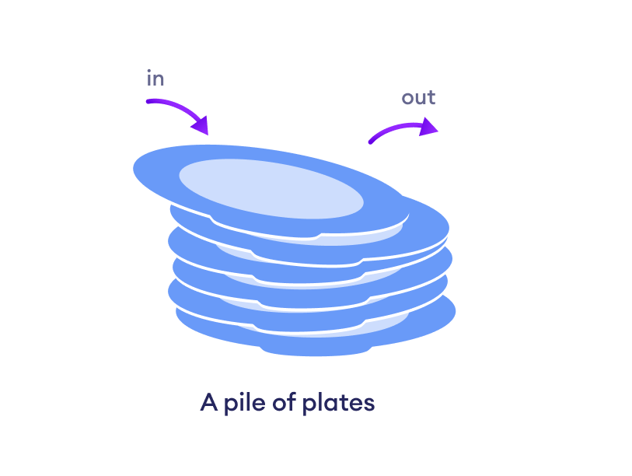
M04 Arrays and Memory Arrays
Method Stack Memory and Heap Memory

Slide 2
Today
Check in
Quiz Module 3 - look in canvas
GE03 - What is do when?
Goals
Declare and initialize arrays using loops and lists
Distinguish between object reference variables and primitive data-type variables
Design algorithms and develop modularized code to accessing array elements using index and processing array contents
Describe rules for arrays
Design algorithms and develop modularized code for different operations on arrays such as displaying, summing, min, max, etc
Describe what memory is allocated on the stack and what is allocated on the heap
Code to set up in your project for today. Download ArraysCode.java and import into your project

Slide 3
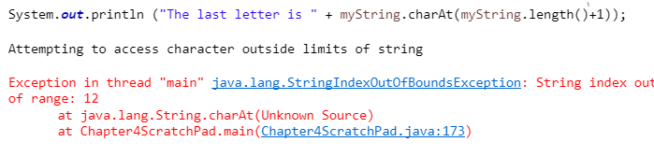
String Review
char
W | i | l | l | y
0 | 1 | 2 | 3 | 4
Index position string
Index starts at position 0
Ends at length of string -1 since starts at position 0 the last index is 4 = 5-1
Notice what happens if you try to access an index that doesn’t exist. For example there is nothing at index 6

Slide 4
Strings and Loops Review
public class M03LoopsConditinsMethods
{
public static void main(String[] args) {
String startingString = "SquarePants";
methodOutputs(startingString);
System.out.printf("\nString after method: %s", startingString);
}
public static void methodOutputs(String stringParameterInput)
{
int stringLength = stringParameterInput.length();
for (int i = (stringLength-1); i >= 0; i--)
{
char currentChar = stringParameterInput.charAt(i);
if (currentChar == 'a' || currentChar == 'e' || currentChar == 'i' ||
currentChar == 'o' || currentChar == 'u') {
currentChar = Character.toLowerCase(currentChar);
}
else {
currentChar = Character.toUpperCase(currentChar);
}
System.out.print(currentChar);
}
}
}
Write down how startingString is stored in memory.
How do you access different characters in the string?
Why is a for loop used here?
Why stringLength-1?
What is the String method length() doing.

Slide 5
Storing Data
We have been using Java Primitive Data Types to store one value.
Think about how you are calculating grades for one student.
What if you have 50 students, 6 categories?
How would you handle multiple students? How would you draw a picture to show all the grades for all the students in the class?
Grades - How could we store data like this in Java?

Slide 6
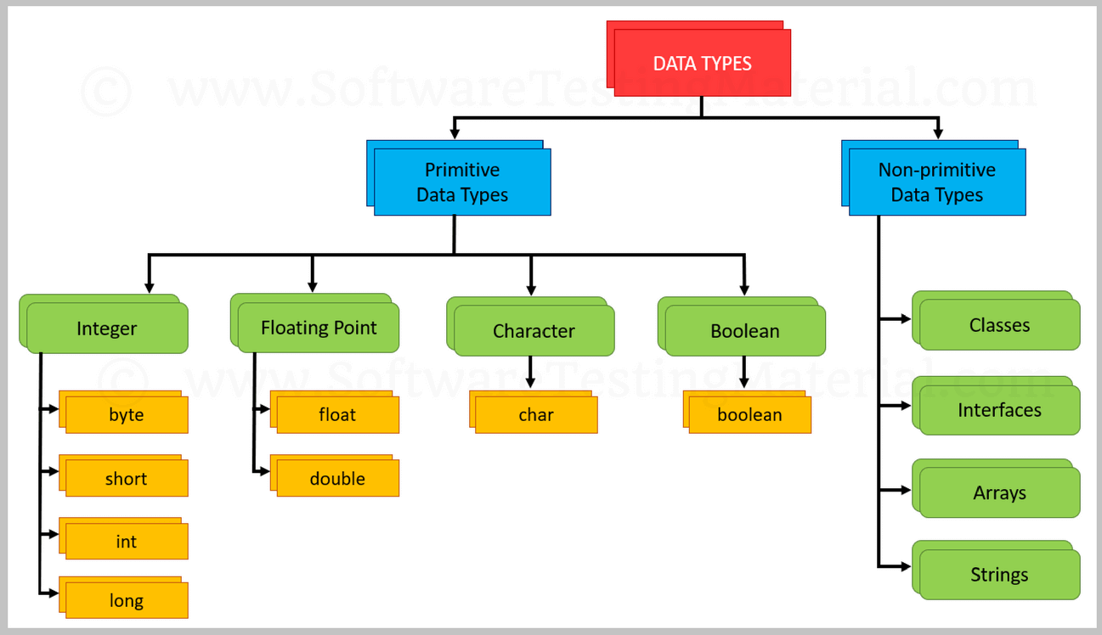
Arrays
In java there is a structure called an array that provides a way to store more than one value but they must be the same data type. An array is a data structure.
For example, you can store the grades as a double for a student in an array.
Explore animation and compile code fof AnalyzeNumbers.

Slide 7
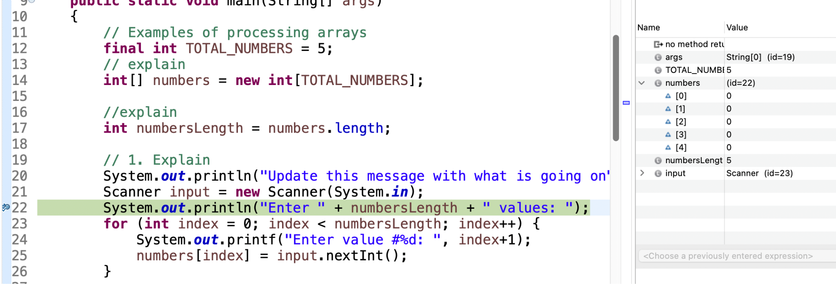
Class Participation
Debug, discuss and add comments in class code explaining what you think is going on.
Click on arrow to see what is in the number variable

Slide 8
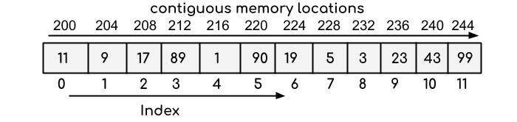
Array
What is an array?
An array is a container that provides a way to store more than one value
An array is a group of contiguous memory locations that all have the same type.
Why Use Arrays
Provides ability to store a fixed set of values of the same type
Can access that set of values through one variable name

Slide 9
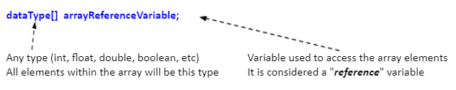
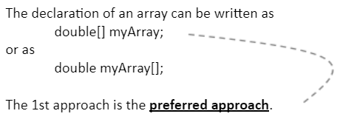
Declaring Arrays
When defining an array, you are defining
What type of elements the array can store
The variable name that will be a "reference" to the array
The number of elements the array will hold
General form for declaring an array:
What do you think happens when you declare an array?
We will use this approach

Slide 10
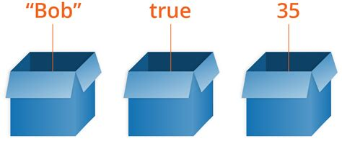
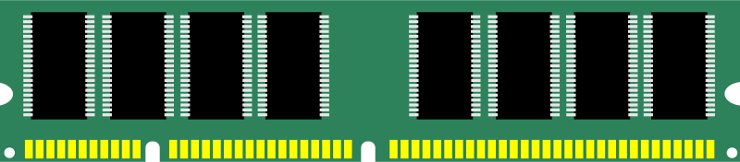
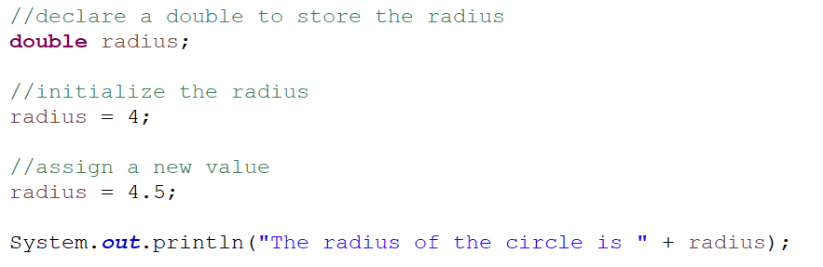
Review Memory Primitive Datatypes
Variables are used to store a value that may change (vary)
Have a data type
Are stored in computer memory
Have scope - defines the part of the program where the variable is accessible.
What we do with variables
Declare identifier and data type
Initialize by assigning a value in memory
Assign a new value in memory
Read the value from memory
Identer to assign value in memory or to read value from memory
radius
009AFD30
4
Create location in memory to with enough bytes to store a double. The memory location identifier of the variable is radius
Assign the value 4 into memory. Will be stored as a double 4.0.
Assign a new value in memory 4.5.
Get the current value from memory 4.5

Slide 11

Declaring and Creating a New Array: Memory
variable for an array is a reference variable
Identerfier numbers had a memory location holds null until new array created with a size
Declaring array creates memory on the stack for the numbers variable to store the address to refer to where the array will be in memory on the heap. When not initialized it stores null.
numbers
009AFD30
null
This assigns a new array object to hold 5 integers. This creates memory on the heap based on needing 5 integers.
New allocates memory on heap to store each integer
final TOTAL_NUMBERS = 5
0x7fff6771c324
Array name numbers now contains memory address on heap where array starts at index 0. The heap is not on the stack
Memory for each integer is stored consecutively in heap memory
numbers
009AFD30
0x7fff6771c324

Slide 12

Declare an Array
Be aware of the differences when declaring arrays
Primitive Types
Declare an integer -> int number = 7;
The declaration indicates
type of data you are declaring, and
allocates memory
Array Types
Declare an array -> int[] number;
The declaration indicates
type of data the array will store, but
DOES NOT allocate memory for the array!
Only creates a storage location for the reference (i.e. number) to the array
0x7fff6771c324
When variable declared memory allocated for enough bytes to store an int data type

Slide 13
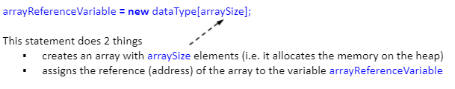
Create Array
Cannot do anything with array variable until after array has been constructed with new operator.
After the array variable is declared - dataType[] arrayReferenceVariable;
Use the new operator to give the array a size
That is, allocate memory for the array
General form for creating an array:

Slide 14
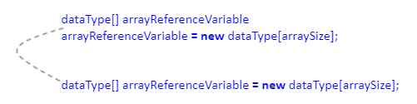
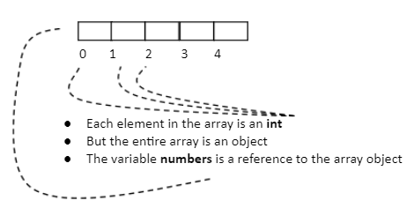
Declaring and Creating in One Step
Instead of using two steps you can do both in one step.
The value stored in numbers is the address of the array at the first index in memory where each element will be stored in consecutively in memory.
And accessed by the index.
What would be the best way to iterate through an array to assign each element a value?

Slide 15


Array Size
Once a new array is created the size can not be changed.
The length of the array is obtained by accessing the "length" property
Note: "length" is a property of an array object
length is established when the array is created
length cannot change after array is created

Slide 16
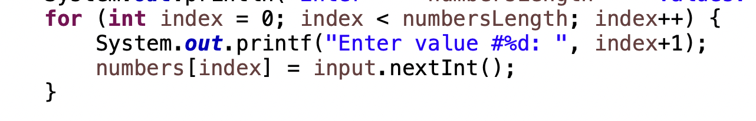
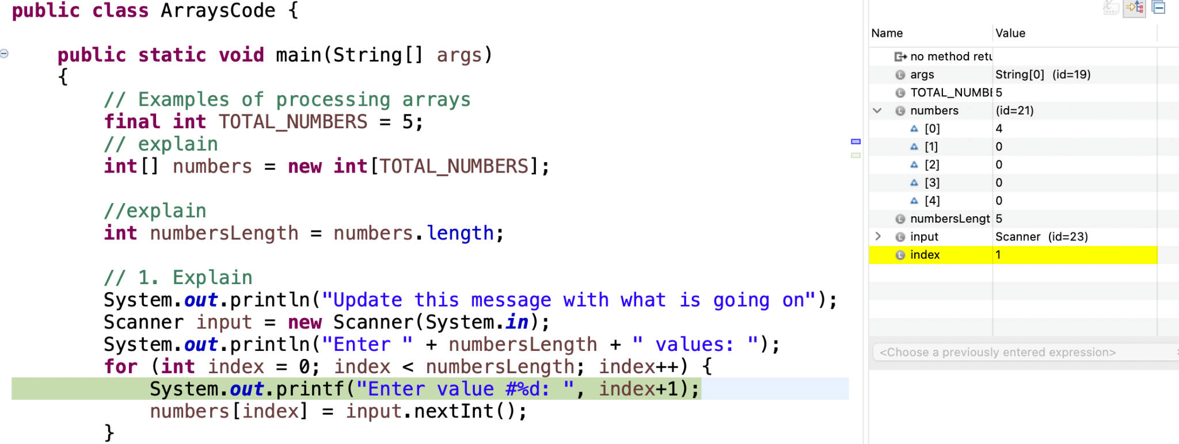
Accessing Array Elements
First time through the for loop index of for loop starts at 0
Notice array name numbers value is id=21. That is because numbers is a reference variable holding where in memory to go on the heap where array starts
First index is 0
Variable index in for loop increments

Slide 17
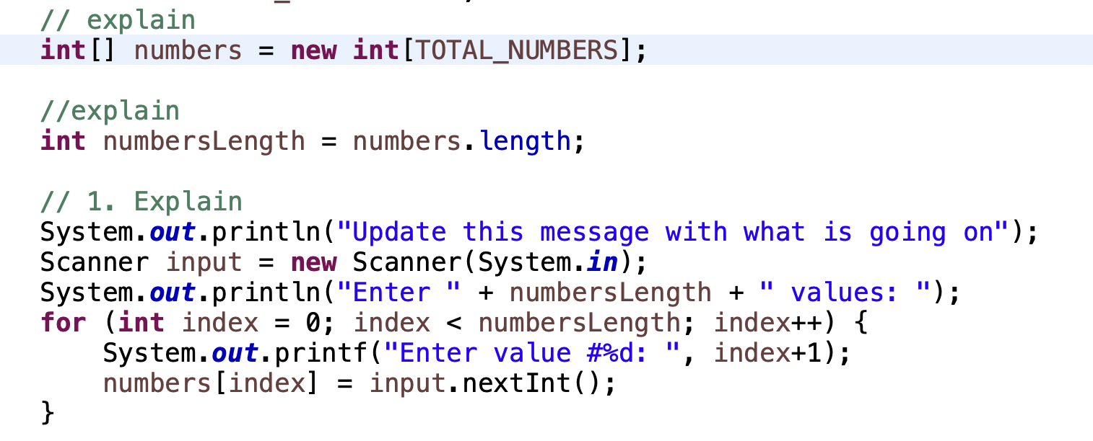
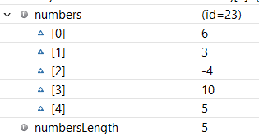
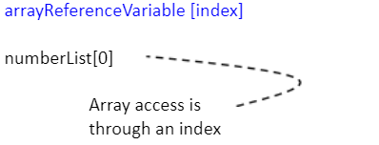
Accessing Array Elements
What do you think will happen if you tried to access index 6 of the array?
d
Notice the last index is one less than the length.
last index is 4

Slide 18
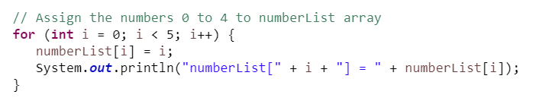
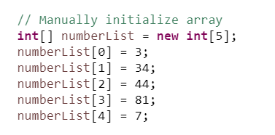
Accessing Array Elements
To access the individual elements within an array use array index notation
For loops are generally used with arrays since we know how many times the loop will occur
To manually assign values to our numberList array we could write code like this:

Slide 19
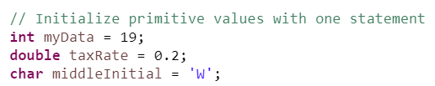

Initializing an Array with a list
Shorthand notation that combines declaration, creation, and initialization into one statement
With primitive types, we declare variables and assigned values (initialized)
With arrays, we can write a statements where the array is declared, created, and initialized an array in one statement with a list of numbers. In this case, the new statement is not used with this approach. This creates enough memory to store 5 integers.

Slide 20
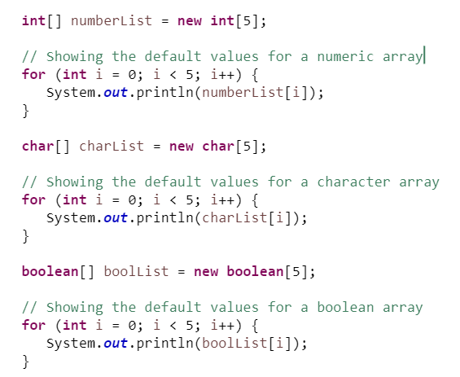
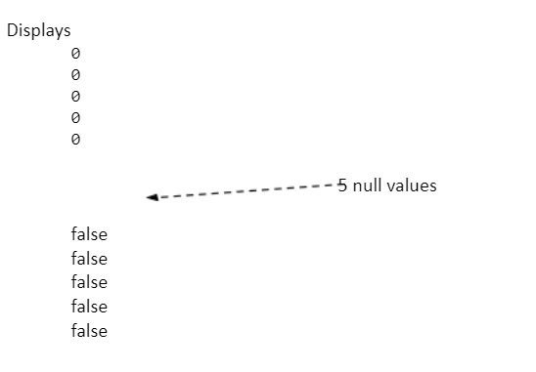
Array Defaults
Unlike other types, when an array of primitives is created, it is filled with default values
The default value is based on the element type the array will store
zero for numeric
\u0000 - for char type - this is Unicode for "null"
false for Boolean type

Slide 21

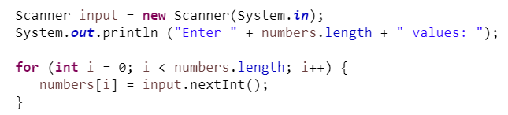
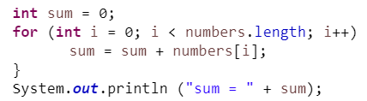
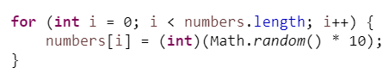
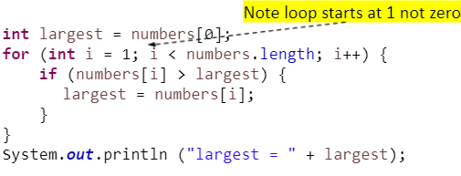
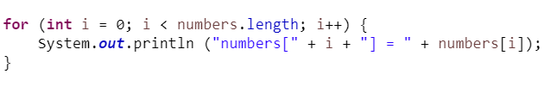
Examples of Processing Arrays
Why are for loops good to use to iterate through an array?
Initialize with input values
Sum Elements
Initialize with random values
Find largest element
Display Array

Slide 22
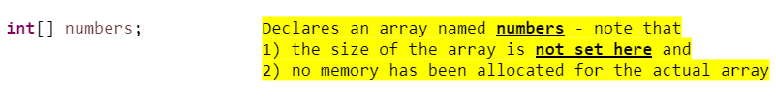
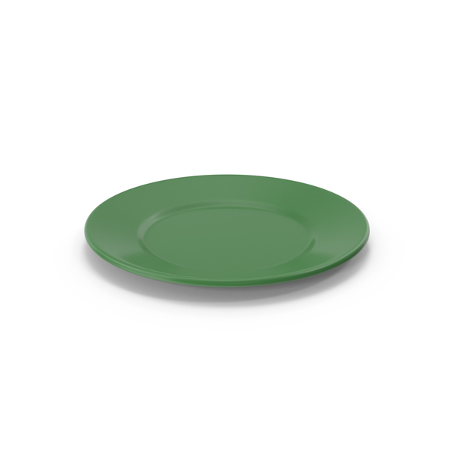
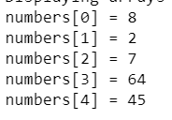
Rules for Arrays
Once created, an array's size is fixed
All elements in an array will be the same type
The array declaration does not allocate memory for the array
You cannot do anything with array variable numbers until array is constructed with the new operator
The value stored in numbers is currently null
After array is created (allocated memory): The value stored in array variable is now the address of the array. A reference variable is used to access the items in an array
To reference an item in an array on the heap use "bracket" notation
Once an array is created it has an associated length variable
Attempting to access an element with an index outside the range of the array is a out of bounds runtime error
numbers stack variable holds the address 0x7fff6771c324 where the array is located on the heap. Values stored in array are located on the heap
Array reference variable numbers refers to where array is on the heap

Slide 23
Preparation
Work on updating today’s lecture code with your team:
// 5. Declare new array called randomNumbers
// 6. Write Code to fill the array with random numbers from 1 to 10
// 7. Write Code to find the index containing the smallest number in the randomNumbers array
// 8. write code to display the index and value of the smallest number
// 9. write a method to return the index containing the smallest number in the randomNumber array
You will submit what you were able to complete for today’s team lab. I do not expect you to complete everything. The goal would be to complete for next week’s lecture.

